Slide 1
IMPORTANCE OF WELL-CHILD VISITS
Insert Presenter Name

Slide 2
WHY ARE WELL-CHILD VISITS IMPORTANT?
Prevention – to ensure your child is healthy & stays healthy, which includes getting recommended immunizations.
Tracking Growth & Development – Track your child’s growth & discuss age appropriate milestones.
Raising Concerns – share any concerns you have regarding your child.
Team Approach – build a relationship with your pediatrician to ensure optimal physical, mental, and social health.
AAP Schedule of Well-Child Care Visits - HealthyChildren.org

Slide 3
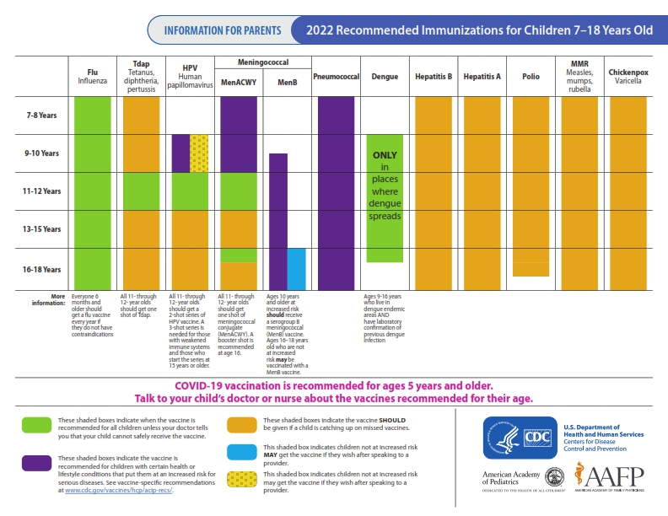
Recommended Vaccinations for Children 7 to 18 Years Old, Parent-Friendly Version (cdc.gov)

Slide 4
BACK TO SCHOOL CHECKLIST
Schedule well-child visit
Schedule sports & activity physical
Get caught up on all recommended immunizations
Visit the dentist
Communicate any special needs to your school nurse – asthma action plan, epi pen, make sure needed medications are on file, etc.

Slide 5
HEALTH SCREENINGS OFFERED AT SCHOOL
INSERT ANY SCREENINGS OR SERVICES

Slide 6
ADD IN SCHOOL HEALTH TEAM CONTACT INFORMATION

